Slide 1


1. Project Description: Story of Snake game.
Snake is an arcade game that was created back in the 1970's. It's been ported to almost all systems.

Slide 2
2. Game Description.
In the game of Snake, the player uses the arrow keys to move a "snake" around the board. As the snake finds food, it eats the food, and thereby grows larger.

Slide 3
The snake that you play with.
The food that you eat and grow.

Slide 4
3. Gameplay

Slide 5
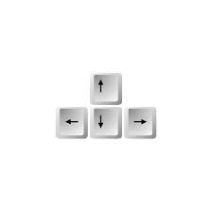

Left, Right, Up and Down Arrow keys: moves the snake into the direction you want.
R key is used to play again.

Slide 6
how to finsh the game:
The only way to finsh the game is to eat all the food that respawns in the screen till the snake cover the screen.

Slide 7
Github link: https://github.com/almahwiti/almahwiti-CC3-FinalProjectSnake

